Slide 1
Python 101
Lecture 2

Slide 2
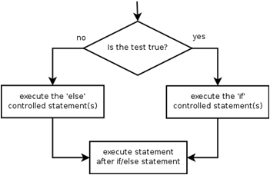
if/else
if/else statement:
Syntax:
if condition:
statements
else:
statements
Example:
gpa = 1.4
if gpa > 2.0:
print("Welcome to Mars University!")
else:
print("Your application is denied.")

Slide 3
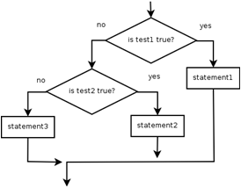
if/elif/else
Multiple conditions can be chained with elif ("else if"):
if condition:
statements
elif condition:
statements
else:
statements

Slide 4
Proposition, Statements, and Conditions
Proposition: “a == b”, boolean: True, False
x = 1 →

Slide 5
Proposition, Statements, and Conditions
Proposition: “a == b”, boolean: True, False
x = 1 → Valid

Slide 6
Proposition, Statements, and Conditions
Proposition: “a == b”, boolean: True, False
x = 1 → Valid
y = x == 1 →

Slide 7
Proposition, Statements, and Conditions
Proposition: “a == b”, boolean: True, False
x = 1 → Valid
y = x == 1 → Valid

Slide 8
Proposition, Statements, and Conditions
Proposition: “a == b”, boolean: True, False
x = 1 → Valid
y = x == 1 → Valid
if y: ... →

Slide 9
Proposition, Statements, and Conditions
Proposition: “a == b”, boolean: True, False
x = 1 → Valid
y = x == 1 → Valid
if y: ... → Valid

Slide 10
Proposition, Statements, and Conditions
Proposition: “a == b”, boolean: True, False
x = 1 → Valid
y = x == 1 → Valid
if y: ... → Valid
if x << 4: →

Slide 11
Proposition, Statements, and Conditions
Proposition: “a == b”, boolean: True, False
x = 1 → Valid
y = x == 1 → Valid
if y: ... → Valid
if x << 4: → Valid

Slide 12
Proposition, Statements, and Conditions
Proposition: “a == b”, boolean: True, False
x = 1 → Valid
y = x == 1 → Valid
if y: ... → Valid
if x << 4: → Valid
if -10 < x < 10: →

Slide 13
Proposition, Statements, and Conditions
Proposition: “a == b”, boolean: True, False
x = 1 → Valid
y = x == 1 → Valid
if y: ... → Valid
if x << 4: → Valid
if -10 < x < 10: → Valid

Slide 14
Data Structures: List
list1 = ['Welcome', 'to', 'Java', 'Lab’]
list2 = [2, 5, 899877, ‘hi’, -1, ‘5’]

Slide 15
List Functions
append → Adds an element to the end of the list
extend → Adds all elements of a list to another list
insert → Inserts an item at the defined index
remove → Removes an item from the list
pop → Removes and returns an element at the given index
clear → Removes all items from the list
index → Returns the index of the first matched item
count → Returns the count of occurrences of an item
sort → Sorts items in a list in ascending order
reverse → Reverses the order of items in the list
copy → Returns a copy of the list

Slide 16
List Functions (cont.)
mylist = ['one', 'two', 'three', 'four', 'five']
mylist.append("new one")
print(mylist)
Output:['one', 'two', 'three', 'four', 'five', 'new one']
mylist.remove('two')
print(mylist)
Output:['one', 'three', 'four', 'five', 'new one']
print(mylist.index('four'))
Output: 2

Slide 17
Examples

Slide 18
Absolute Value
Write a Python code that asks the user for a number, calculate the absolute value of the number and print it.
(without using abs function)

Slide 19
Minimum Value
Write a Python code that asks the user for three numbers, calculate the minimum of them and print it.

Slide 20
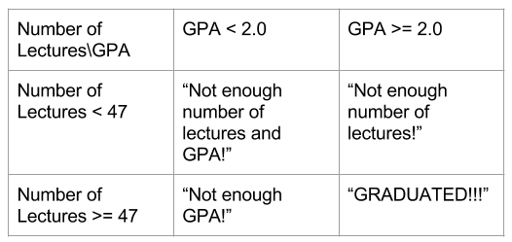
Graduation Condition
Write a Python code to ask user to enter two values: one for GPA and the other for Number of Lectures. According to the below table, decide whether user will be graduated or not. If not, give an appropriate message as given table.

Slide 21
Ticket Discount
Write a Python program that asks user for age and calculates ticket price accordingly:
Normal bus ticket price is 3 TL.
Bus ticket price for people younger than 6 and older than 60 years old is free.
People whose age are between 6 and 18 take 50% discount.

Slide 22
Seasons
Write a Python program that reads a month and day from the user. Your program should display the season associated with the date that was entered.
Season | First Day
Spring | March 20
Summer | June 21
Fall | September 22
Winter | December 21

Slide 23
Roots of Quadratic Equation
Write a Python code that asks the user for parameters(a, b, c) of a quadratic equation represented as: ax² + bx + c = 0. The code should calculate & print out the roots accordingly.
Discriminant:
When Δ>0, there are two real roots (Display both of them!)
When Δ=0, there is one real root (Display it)
When Δ<0, there is no real roots.
Hint: Δ = b² - 4ac

